Slide 1
Software Architecture Design Documentation and Patterns
COMP6100001 - Software engineering
Session 10
Kenny Jingga, S.Kom., M.T.

Slide 2
Session 10 – Software Architecture Design Documentation and Patterns
Learning objectives
At the end of this session, students will be expected to be able to:
Understand the Importance of Documenting Software Architecture
Identify Key Components of Architectural Documentation
Introduce Common Architectural Patterns and Their Applications
Apply Documentation Standards and Best Practices

Slide 3
Session 10 – Software Architecture Design Documentation and Patterns
Content outline
Documenting Software Architecture
Architecture Description Languages (ADLs)
Creating Architectural Views: Logical, Development, Process, Physical
Evaluating and Validating Architecture
Introduction to Architectural Patterns
Applying Documentation Standards and Best Practices

Slide 4
Documenting Software Architecture
Purpose of Architecture Documentation
Documentation provides a blueprint for system design and serves as a communication tool between developers, stakeholders, and project managers.
Key reasons include:
  Ensuring design consistency across teams.
  Providing a reference point for future maintenance and scaling.
  Capturing architectural decisions and their justifications to support knowledge transfer.
Example: An overview document for a banking app that includes system objectives, key decisions, and architectural constraints.

Slide 5
Documenting Software Architecture
Types of Architecture Documentation and levels
Overview Documents: High-level descriptions that outline system objectives, design choices, and constraints.
Detailed Design Documents: Technical documents specifying components, connections, data flow, and security measures.
Documentation Levels:
High-Level Documentation: For non-technical stakeholders, providing a functional overview without technical specifics.
Low-Level Documentation: Focuses on code structures, algorithms, and system integration for technical team members.

Slide 6
Architecture Description Languages (ADLS)
Definition and Role of ADLS
ADLs are specialized languages for describing system architecture, specifying components, connectors, and system configurations. They provide a formal way to capture the high-level design of software systems.
Examples of Common ADLs:
  UML (Unified Modeling Language): Widely used to create visual diagrams like class, sequence, and use case diagrams.
  Acme: A research-focused ADL for defining architectural styles and patterns.
Benefits:
  Facilitates early error detection and design improvements.
  Enhances communication between design and implementation teams.
  Supports automated code generation and design analysis.

Slide 7
Creating Architectural Views
Introduction to Architectural Views
Architectural views are perspectives on the system design created to address the needs of specific stakeholders.
Different views improve the understanding and analysis of the system’s structure and function.

Slide 8
Creating Architectural Views
Types of Views
Logical View: Illustrates the system’s main functionalities, focusing on interactions among major components. Example: Showing user interaction with login, dashboard, and account modules.
Development View: Describes the system from a developer's perspective, typically focusing on the organization of modules and layers. Example: Showing module dependencies for back-end and front-end teams.
Process View: Highlights the runtime behavior of the system, including concurrency and communication among processes. Example: Tracking user actions through microservices in an e-commerce app.
Physical View: Represents the deployment aspect, including the physical hardware and network topology. Example: Illustrating server locations for a cloud-based application to meet scalability needs.

Slide 9

Creating Architectural Views
Choosing Relevant Views
Selecting views depends on the stakeholders' needs (business, developers, IT operations), ensuring that all functional and technical aspects are covered for the audience.

Slide 10

Evaluating and Validating Architecture
Importance of Architecture Evaluation
Regularly evaluating architecture ensures it aligns with the system’s non-functional requirements, such as scalability, security, and performance.

Slide 11
Evaluating and Validating Architecture
Evaluation techniques
ATAM (Architecture Tradeoff Analysis Method):
  Used to understand trade-offs in architectural decisions (e.g., security vs. performance).
  Process: Identifying architectural approaches, analyzing quality attributes, and evaluating trade-offs.
  Example: For a healthcare app, prioritizing security over system performance..
CBAM (Cost-Benefit Analysis Method):
  Used to estimate the economic impact of architectural decisions.
  Process: Mapping architectural components to costs and expected benefits, helping to justify design decisions based on ROI.

Slide 12
Evaluating and Validating Architecture
Validation techniques
Prototyping: Developing a small-scale version to test assumptions about the architecture.
Simulations and Peer Reviews: Review the architecture with experts to identify potential improvements and detect flaws early.

Slide 13
Introduction to Architectural Patterns
understanding Architectural Patterns
Patterns are established solutions for common design problems, helping architects ensure structural integrity and adaptability.
Common Patterns:
  Layered (n-Tier): Organizes the system into separate layers, each responsible for a specific type of functionality. Use case: Suitable for systems requiring clear separation of concerns, such as an online store with separate UI, business logic, and data layers.
  Client-Server: Distributes work between clients (requesters) and servers (providers). Use case: Widely used in database applications and distributed systems.
  Microservices: Composes an application from loosely coupled, independently deployable services. Use case: Large systems requiring scalability, flexibility, and independent deployment.
  Event-Driven: Focuses on real-time responsiveness, where events trigger processing within the system. Use case: Applications requiring quick response to data changes, like a social media feed.

Slide 14
Introduction to Architectural Patterns
Pattern Selection and Trade-offs
Selecting patterns is based on project requirements; e.g., a microservices pattern suits scalability needs, while a layered pattern works for simpler systems with distinct layers.

Slide 15
Applying Documentation Standards and Best Practices
Importance of Standards in Documentation
Standards create uniformity in documentation, simplifying collaboration and ensuring that documentation remains useful over time.
Best Practices for Effective Documentation:
  Modularity: Organize documentation in self-contained sections for easy updates and reuse.
  Version Control: Track documentation updates to maintain a history of architectural changes and decisions.
  Continuous Updates: Synchronize documentation with system changes to avoid outdated or irrelevant information.

Slide 16
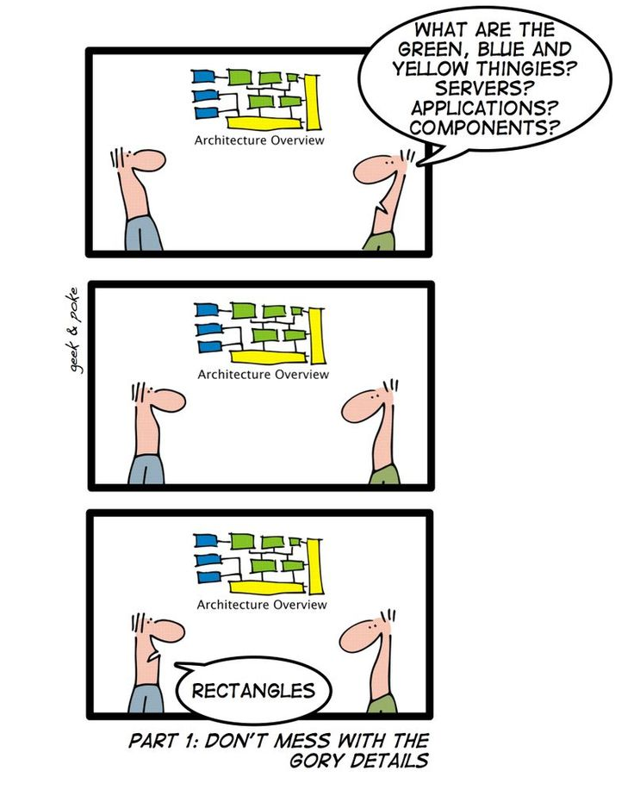
Applying Documentation Standards and Best Practices
Guidelines for selecting a notation
Suitable for purpose
Often visual for compact representation
Usually, boxes and arrows
UML possible (semi-formal), but possibly constraining
  Note the different abstraction level – Subsystems or processes, not classes or objects
Formal notations available
Decompose diagrams hierarchically and in views
Always include a legend
Define precisely what the boxes mean
Define precisely what the lines mean
Do not try to do too much in one diagram
  Each view of architecture should fit on a page
  Use hierarchy

Slide 17
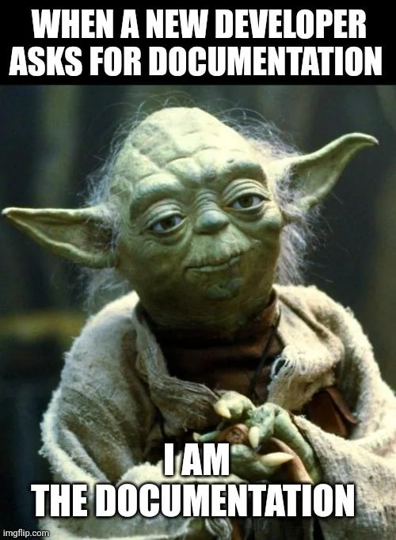
Applying Documentation Standards and Best Practices
Examples of Tools and Templates
Tools like Confluence, Google Docs, or JIRA provide templates that standardize architecture documents.
Example: A Confluence template for software architecture that includes sections for high-level design, component details, and dependencies.

Slide 18
References
Titus Winters, Tom Manshreck, and Hyrum Wright. (2020). Software Engineering at Google: Lesson Learned from Programming Over Time. 1st. O’Reilly Media. California. ISBN: 978-1492082798.
Roger Pressman and Bruce Maxim. (2020). Software Engineering: A Practitioner's Approach. 9th. McGraw Hill. New York. ISBN: 978-1259872976.
Ian Sommerville. (2016). Software Engineering. 10th. Pearson. London. ISBN: 978-1-292-09613-1.

